Slide 1

Student management System

Slide 2
Hossain,Muntasir →18-36421-1 Borno,md.sirajuddin →18-36449-1 Mazumdar Urmila →
Team Members

Slide 3
Contents
Introduction
User
Features
Making of this application
Conclusion

Slide 4
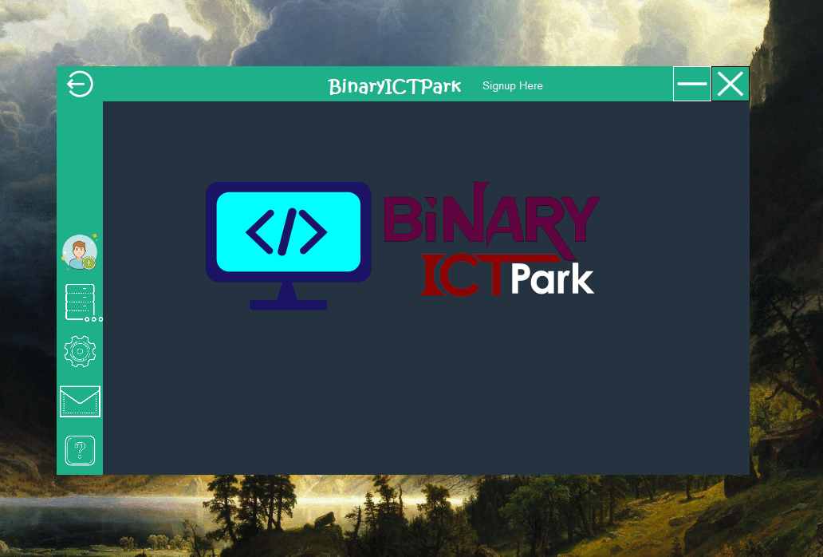
Introduction:
This is application is created to manage students.
This will help managing Students as well as all batches.
It’s a very simple and efficient system to manage student.

Slide 5
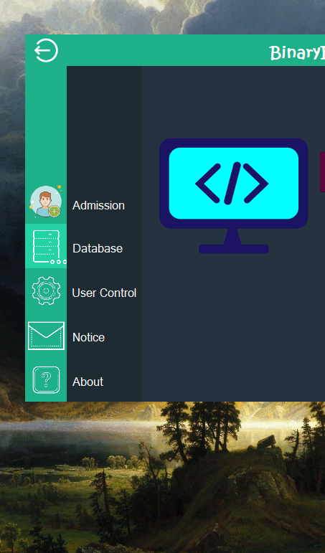

Features:
User:
Admin
Manager
Add new Students
View DataBase
Send Notice

Slide 6




Making of this application:
Language: C Sharp
Application : Visual Studio 2017
DataBase: MicroSoft SQL Server Management Studio
Use Case diagram
Activity Diagram
Class Diagram
E-R Diagram

Slide 7
Conclusion :
We are using Scrum as Software model.
This helped us a lot to develop this Project.
Thank you

